Slide 1
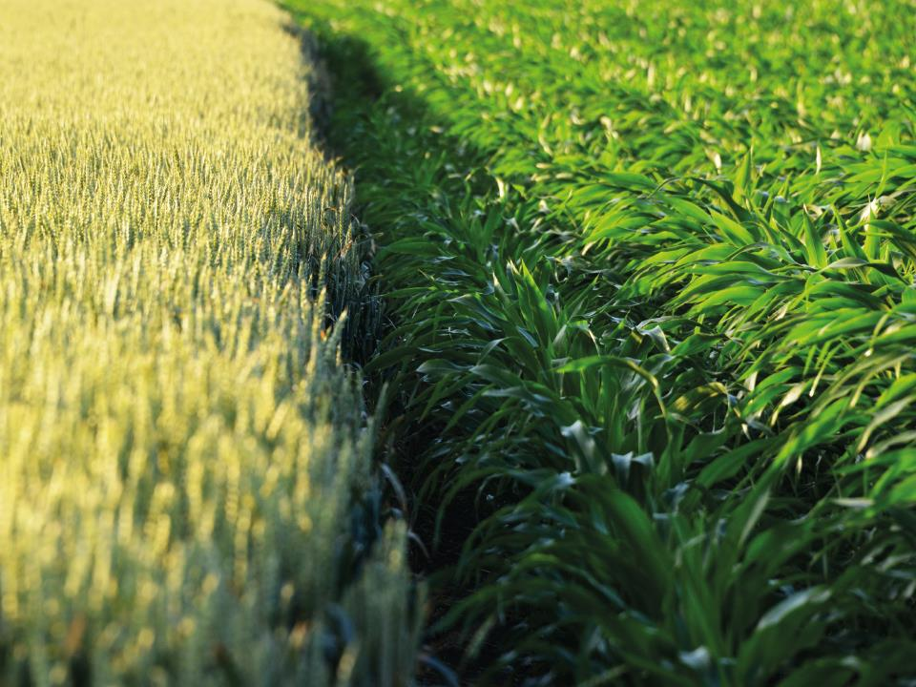
Odex4All use case
02/04/2015
N. Heslot

Slide 2
Use case
“The identification of the biological mechanism underlying quantitative trait loci (QTL) to establish an informed link between QTL interval(s) for a trait and genes candidate explaining the phenotype.”
From statistical analysis (GWAS, QTL mapping)
Area of interest of the genome can be identified
Those regions can be quite large (up to 100s of genes)
Need to prioritize the regions for further investigations
Need tools to identify the most promising genes in the region

Slide 3
Information sources
Scientific publications
Databases:
http://wheat.pw.usda.gov/GG2/index.shtml
http://www.gramene.org/
http://metacyc.org/
http://harvest.ucr.edu/
http://www.panzea.org/
http://www.ncbi.nlm.nih.gov/sites/gquery
https://www.arabidopsis.org/index.jsp
http://www.maizegdb.org/
http://www.plantgdb.org/OsGDB/
Patents

Slide 4
Connexion between data sources
Gene name (ex tb1 in maize)
Region of the genome (ex short arm of chromosome 1 in maize)
Synteny between organism (similar region or gene in a better known organism)
Trait (ex yield in maize)
If the region was found in a specific genetic material, the name of that ressource

Slide 5
Specific use case
US patent application: Genetic markers associated with drought tolerance in maize
US 2015/0033406 A1
In that patent application, regions of the maize genome contributing to drought resistance are identified, as well as the genetic source
Questions:
What can be learned about those regions in the publicly available data?
Can we identify the genes of interest in those regions?
Is their prior art that would invalidate the patentability of some of the claims?

Slide 6

Thank you

